Slide 2
ACCESSING & MODIFYING DOM

Slide 3
REFERENCE MATERIAL

Slide 4
INTRODUCTION

Slide 5
HTML,CSS & JavaScript
Your Browser =HTML + CSS + JavaScript
HTML Defines the Structure
CSS defines aesthetic and layout appeal
JavaScript provides interactivity

Slide 6

What is interactive

Slide 7
DOM
Document Object Model
a hierarchical structure that your browser uses to make sense of everything on a webpage
DOM is made up of nodes
Nodes consist of
elements
attributes,
text content,
comments,
document-related stuff,
Every HTML element you want to access has a particular type associated with it, and all of these types extend from the Node base that make up all nodes:

Slide 8
JavaScript & DOM
Changes made to the DOM via JavaScript is reflected in what gets shown in the browser
Using JavaScript you can
dynamically add elements
remove them
move them around
modify attributes on them
set CSS styles
A fully functioning webpage can be made using only JavaScript

Slide 9
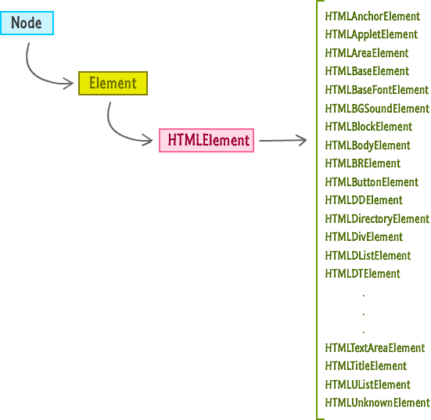

Slide 10
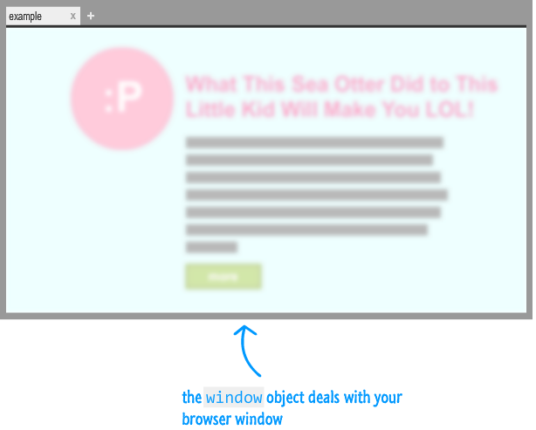
The Window Object
A global object that contains many properties and methods that help to work with a browser

Slide 11
The Document Object
The document object is the gateway to all the HTML elements on a webpage
Document object is not a read-only version of the HTML document.
It is used to read as well as manipulate HTML documents at will.

Slide 12
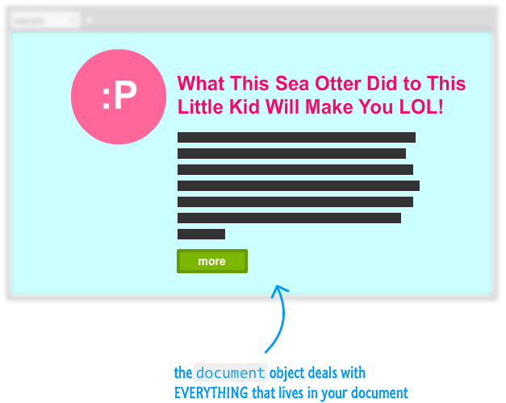
The Document Object

Slide 13
<!DOCTYPE html>
<html>
<head>
<meta content="sea otter, kid, stuff" name="keywords">
<meta content="Sometimes, sea otters are awesome!" name="description">
<title>LOL! Sea Otter! Little Kid!</title>
<link href="foo.css" rel="stylesheet"/>
</head>
<body>
<div id="container">
<img src="seaOtter.png"/>
<h1>The Sea Otter Did to This Little Kid Will Make You LOL!</h1>
<p class="bodyText">
Nulla tristique, justo eget semper viverra, massa arcu hendrerit at semper sed, feugiat a nisi.
<p>
<div class="submitButton">
next
</div>
</div>
<script src="stuff.js"></script>
</body>
</html>

Slide 14
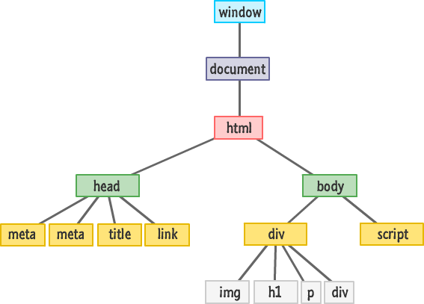

Slide 15
Querying the DOM
document.getElementById
document/node.getElementsByTagName
document.getElementsByName
document/node.getElementsByClassName
querySelector
querySelectorAll

Slide 16
document.getElementById
<body>
<div id="info">Info</div>
<script>
var div = document.getElementById('info')
alert( div.innerHTML )
</script>
</body>
Return a single element (node) with certain id.
If no element is found, null is returned.

Slide 17
querySelector
var element = document.querySelector("< CSS selector >");
querySelector function takes a CSS selector as argument.
Returns the first element it finds that matches the selector
var element = document.querySelector("#main");
var element = document.querySelector(".pictureContainer");

Slide 18
DEMO
<div id="main">
<div class="pictureContainer">
<img class="theimage" src="smiley.png" height="300" width="150"/>
</div>
<div class="pictureContainer">
<img class="theimage" src="tongue.png" height="300" width="150"/>
</div>
<div class="pictureContainer">
<img class="theimage" src="meh.png" height="300" width="150"/>
</div>
<div class="pictureContainer">
<img class="theimage" src="sad.png" height="300" width="150"/>
</div>
</div>

Slide 19
querySelectorAll
var elements = document.querySelectorAll("< CSS selector >");
Returns an array of elements!
var images = document.querySelectorAll(".theimage");
for (var i = 0; i < images.length; i++) {
var image = images[i];
alert(image.getAttribute(src));
}

Slide 20
querySelectorAll
var images = document.querySelectorAll("img");
var images = document.querySelectorAll("img[src='meh.png']");

Slide 21
Caution!!
Not all pseudo-class selectors are allowed. A selector made up of :visited or :link is ignored and no elements are found.
How crazy you can go with the selectors you provide depends on the browser's CSS support. Internet Explorer 8 supports querySelectorand querySelectorAll. It doesn't support CSS3. Given that situation, using anything more recent than the selectors defined in CSS 2 will not work when used with querySelector and querySelectorAll on IE8.
The selector you specify only applies to the descendants of the starting element you are beginning your search from. The starting element itself is not included.

Slide 22
Modifying the DOM
Every HTML tag, style rule, and other things that go into your page has a corresponding representation in the DOM.
HTML elements are so versatile when viewed via the DOM is because they share a lot of similarities with JavaScript Objects.

Slide 23
A simple example!!!
<html>
<head>
<title>Hello...</title>
<style>
.highlight {
font-family: "Arial";
padding: 30px;}
.summer {
font-size: 64px;
color: #0099FF; }
</style>
</head>
<body>
<h1 id="theTitle" class="highlight summer">
What'shappening?</h1>
<script>
</script>
</body>

Slide 24
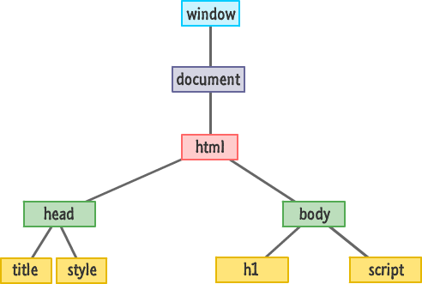

Slide 25
Modify the text
<body>
<h1 id="theTitle" class="highlight summer">What's happening?</h1>
<script>
var title = document.querySelector("#theTitle");
title.textContent = “Nothing going on";
</script>
</body>

Slide 26
getAttribute
<body>
<h1 id="theTitle" class="highlight summer">What's happening?</h1>
<script>
var title = document.querySelector("h1");
alert(title.getAttribute("id"));
</script>
</body>
To retrieve the value of an attribute on the element
returns the value associated with that attribute
if an attribute name doesn't exist, it returns null

Slide 27
setAttribute
<body>
<h1 id="theTitle" class="highlight summer">What's happening?</h1>
<script>
var a=document.getElementById( “theTitle”)
a.setAttibute(“class” ,”foo”)
</script>
</body>
To set the value of an attribute of the element

Slide 28
className
<body>
<h1 id="theTitle" class="highlight summer">What's happening?</h1>
<script>
var title = document.querySelector("h1");
alert(title.id);
title.className = "bar foo";
</script>
</body>
To retrieve the class of any element

Slide 29
Setting Styles
var myElement = document.querySelector("#superman");
myElement.style.backgroundColor ="#D93600";
Every HTML element that you access via JavaScript has a style object.
This object allows you to specify a CSS property and set its value

Slide 30
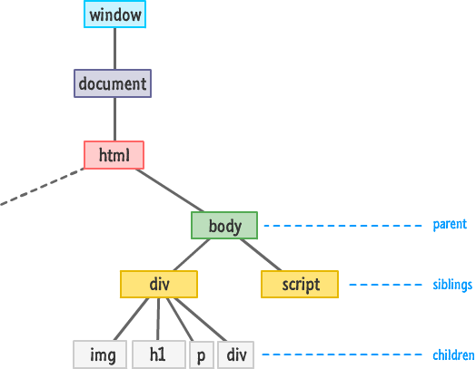
Traversing the DOM

Slide 31
Meet The Family!!
firstChild
lastChild
parentNode
children
previousSibling
nextSibling

Slide 32
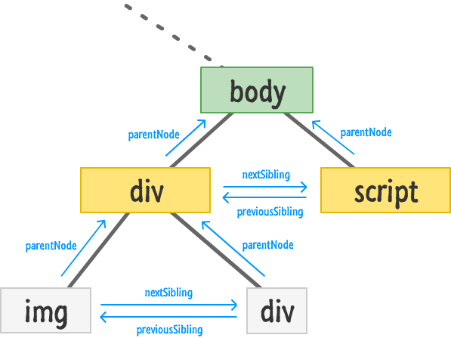

Slide 33
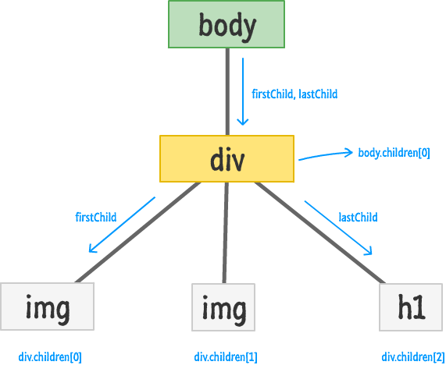

Slide 34
Checking If A Child Exists
var bodyElement = document.body;
if (bodyElement.firstChild) {
// do something interesting
}
If statement will return null if there are no children
Can also be used with
bodyElement.lastChild
bodyElement.children.length

Slide 35
Accessing All the Child Elements
var bodyElement = document.body;
for (var i = 0; i < bodyElement.children.length; i++) {
var childElement = bodyElement.children[i];
alert(childElement.tagName);
}

Slide 36
Creating Elements
document.createElement("p");
To create a new element on a page
Call the createElement method through the document object
Pass the tag name of the object to be created

Slide 37
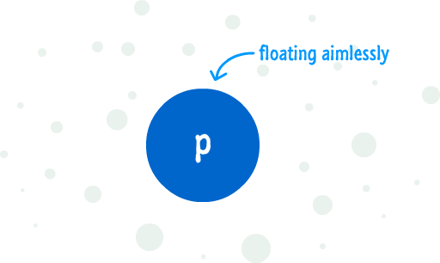
To add it to the DOM
Find an element that will act as the parent
Use appendChild and add the newly created element to the parent element

Slide 38
<body>
<h1 id="theTitle" class="highlight summer">What's happening?</h1>
<script>
var newElement = document.createElement("p");
newElement.textContent = "I exist entirely in your imagination.";
document.body.appendChild(newElement);
</script>
</body>

Slide 39
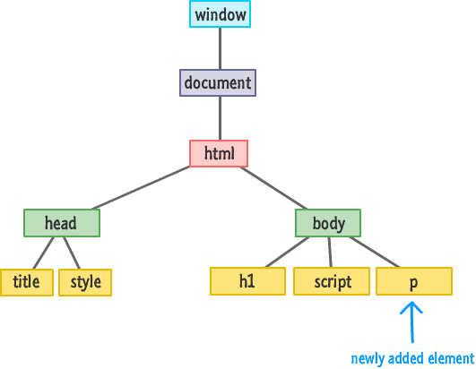
The DOM after appending

Slide 40
insertBefore
<body>
<h1 id="theTitle" class="highlight summer">What's happening?</h1>
<script>
var newElement = document.createElement("p");
newElement.textContent = "I exist entirely in your imagination.";
var scriptElement = document.querySelector("script");
document.body.insertBefore(newElement, scriptElement);
</script>
</body>
The insertBefore function takes two arguments.
The first argument is the element you want to insert.
The second argument is a reference to the sibling you want to precede.

Slide 41
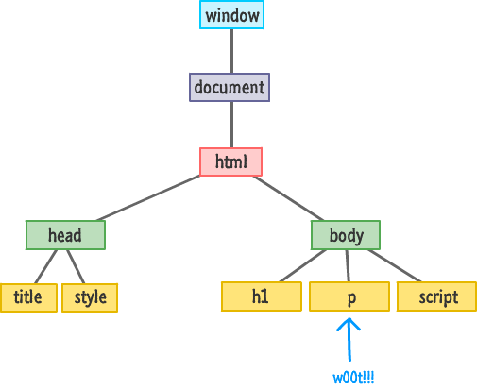

Slide 42
Removing Elements
<body>
<h1 id="theTitle" class="highlight summer">What's happening?</h1>
<script>
var newElement = document.createElement("p");
newElement.textContent = "I exist entirely in your imagination.";
document.body.appendChild(newElement);
document.body.removeChild(newElement);
</script>
</body>

